Slide 1
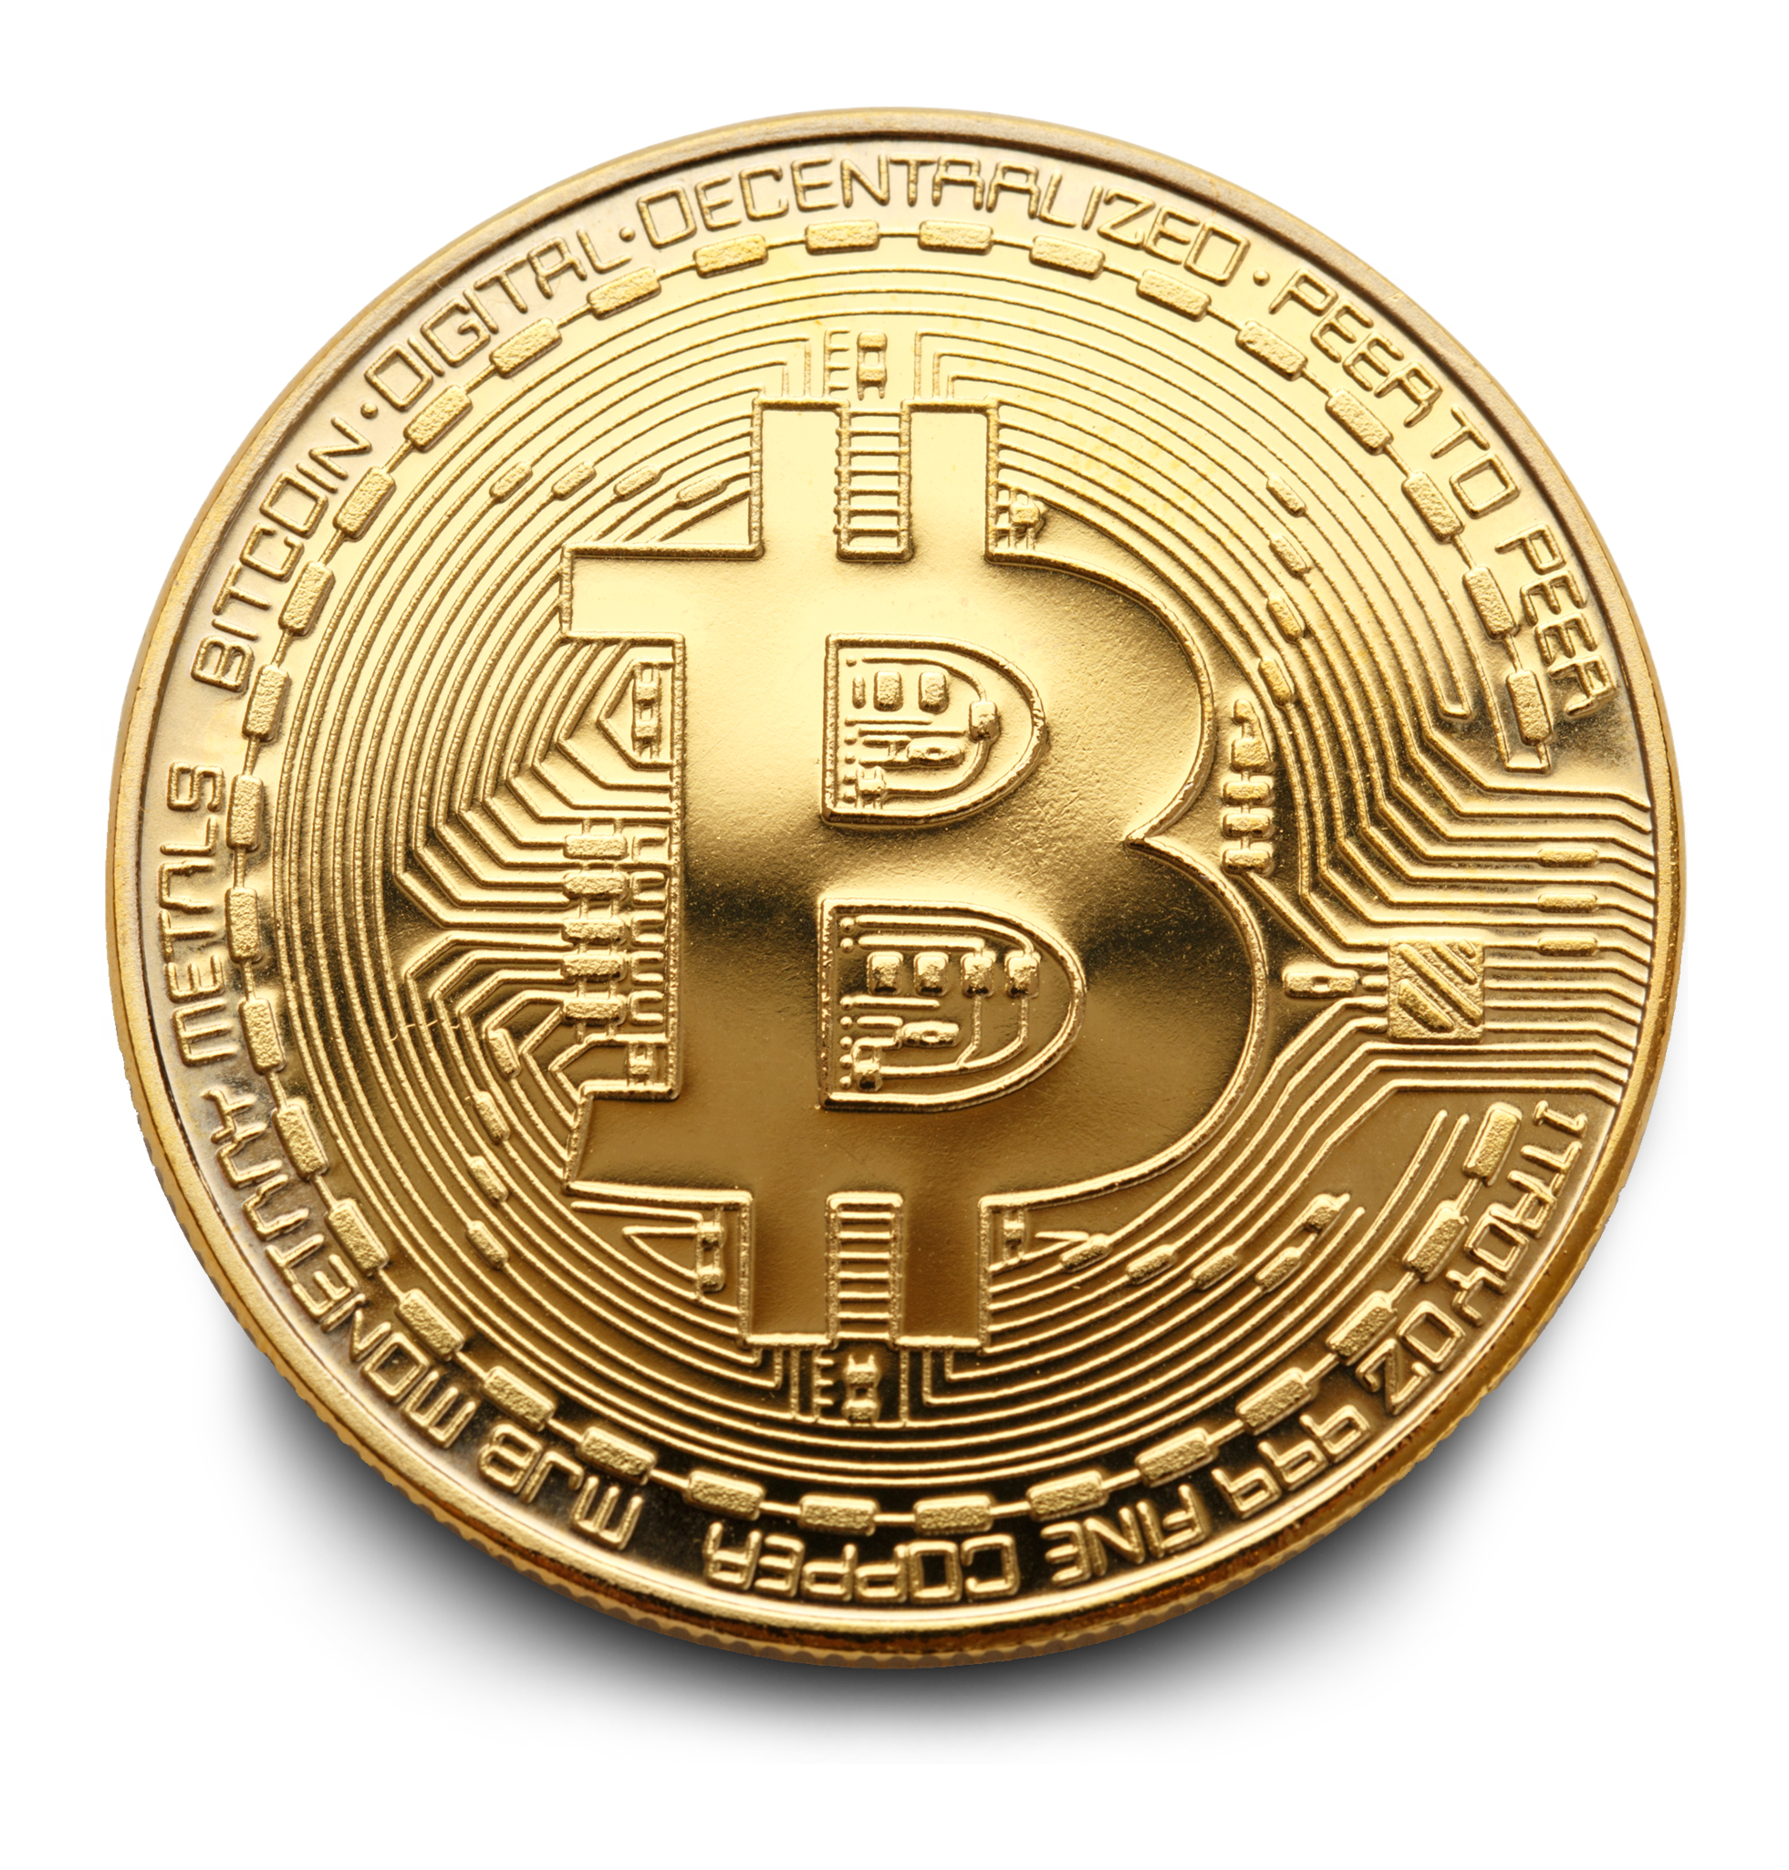
Notes:
Who here has invested in crypto-currency? And suffered?
I did too.

Slide 2

Notes:
Wouldn’t it be nice if we could get some idea regarding what is about to happen?

Slide 3
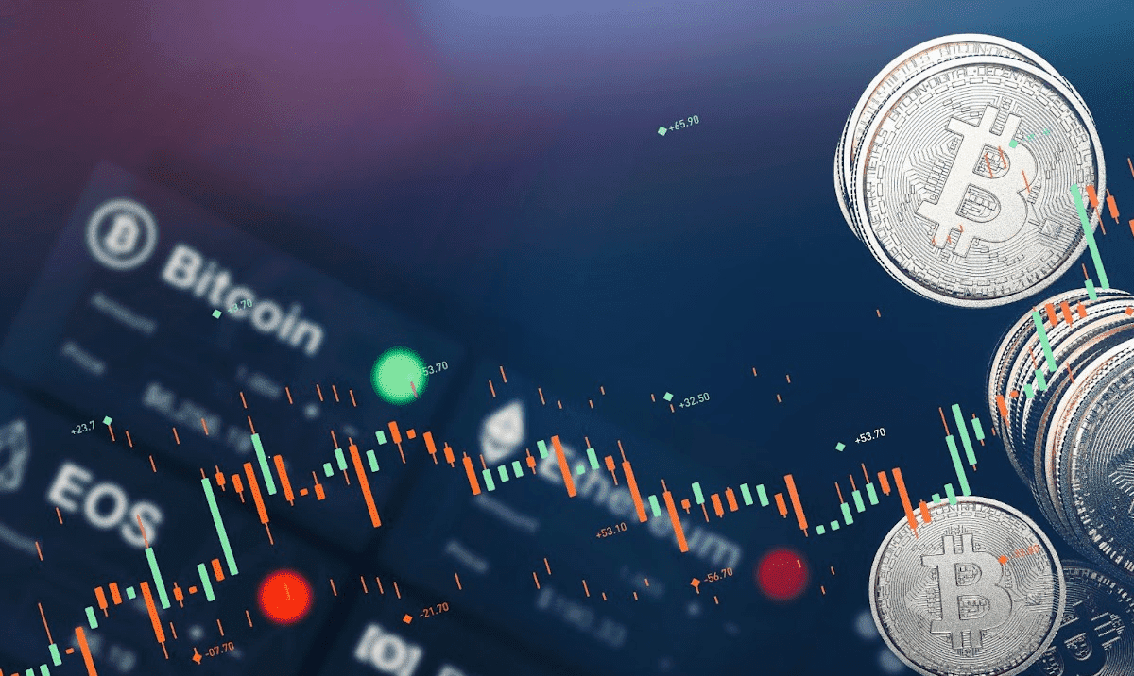
Understanding crypto price fluctuations
Asad | Keerthi | Pranav | Shivaani

Slide 4
Agenda
Overview
Sources of Data
Methodology
Demo
Way Forward

Slide 5
Overview
Sources of Data
Methodology
Demo
Way forward

Slide 6
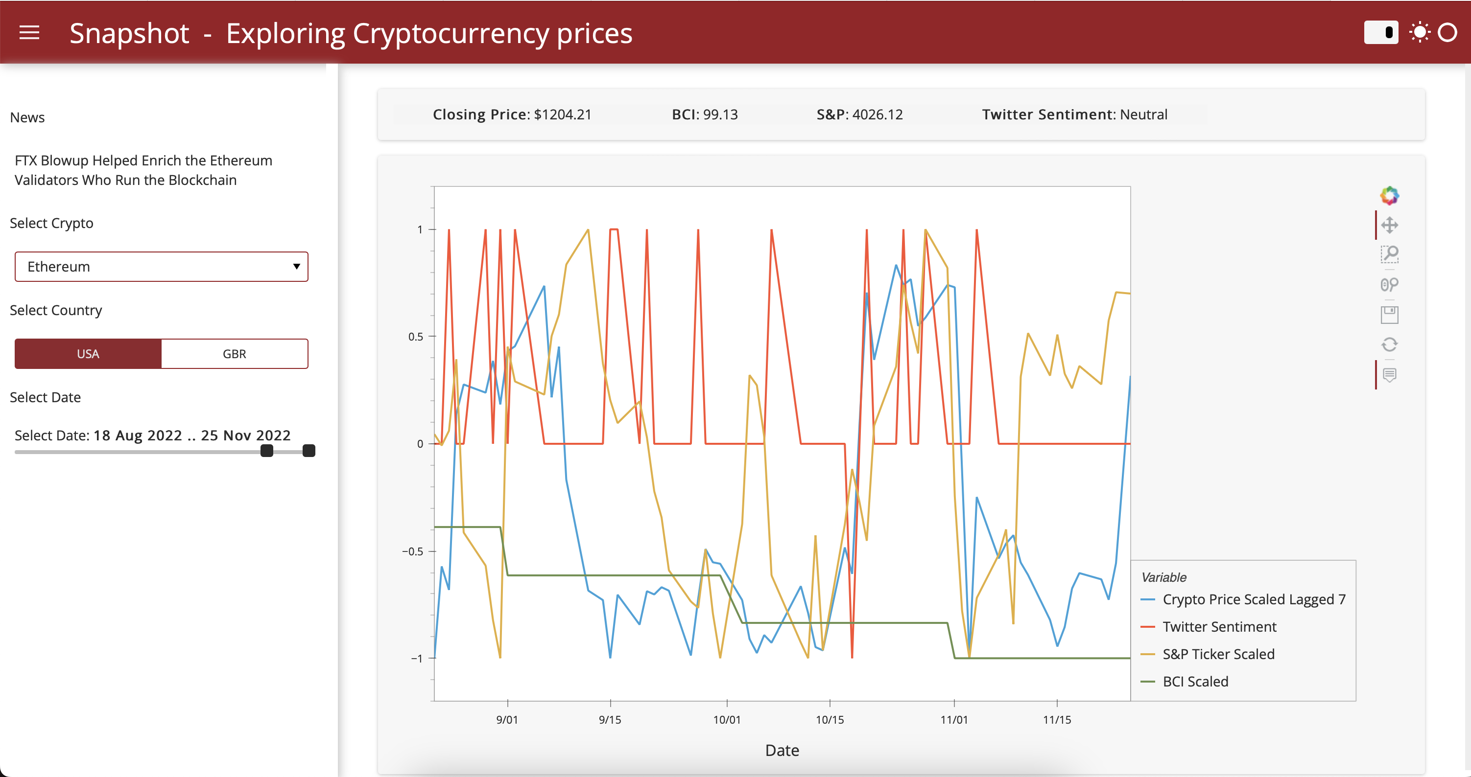
Dashboard SS
Notes:
We made a dashboard to assist in exploratory data analyses for

Slide 7
Overview
Sources of Data
Methodology
Demo
Way forward

Slide 8
Data | Source | Type
1. Tweet | Twint | Web Scraping
2. Crypto-currency prices | Coingecko | API
3. S&P 500 Data (Stock Exchange Indicator) | Yahoo Finance | API
4. Crypto News | Coindesk | Web Scraping
5. Business Confidence Index (macro-economic indicator) | Organization for Economic Co-operation and Development | CSV
Notes:
Business Confidence Index - OECD

Slide 9
Overview
Sources of Data
Methodology
Demo
Way forward

Slide 10
Data
Collect
Clean
Integrate
Visualization*
Research
Build
Explore
*Using hvplot and Panel
Notes:
This is what all of us will be talking about now

Slide 11
Numerical Preprocessing:
Scaling
Lagged in prices - Shivaani

Slide 12
Twitter Pre-processing & Sentiment Analysis - shivaani

Slide 13
Sentiment Analysis - pranav

Slide 14
GUI - Graph

Slide 15
GUI - Keerthi

Slide 16
Overview
Sources of Data
Methodology
Demo
Way forward

